Slide 1
Microwave Circuit Design Project Report
Chebyshev Bandpass Filter Microstrip Line
Student name - Matrikel
Ngoc An Ha - 967813
Duy Hai Nguyen – 968045

Slide 2
Step 1: Create lump element low pass prototype filter.
Transform to lump element bandpass filter circuit.
Step 2: Transformation to a filter structure realizable in microstrip line circuit
Ideal couple transmission line element (CLIN) .
Microstrip couple line (MCLIN).
Microstrip couple line filter (MCFIL) .
Step 3: Include all microstrip line discontinuities.
Step 4: Optimize the circuit.
Step 5: Process on making the real circuit.
Filter type: Bandpass |  | Method: Chebyshev Equal Ripple
Order: N= 3 | Ripple = 0.5 dB | Center Frequency F₀ = 2.45 GHz | Bandwidth B=100 MHz
N | G1 | G2 | G3 | G4
3 | 1.596 | 1.097 | 1.596 | 1

Slide 3
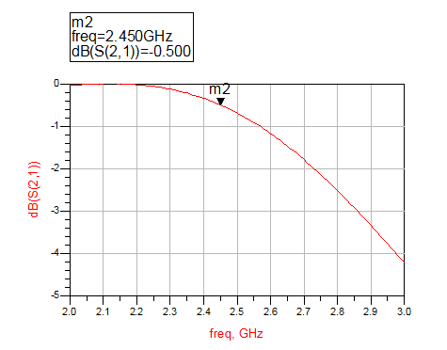
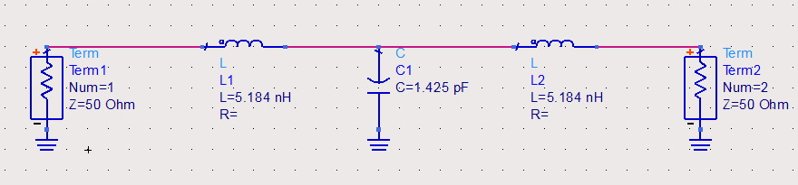
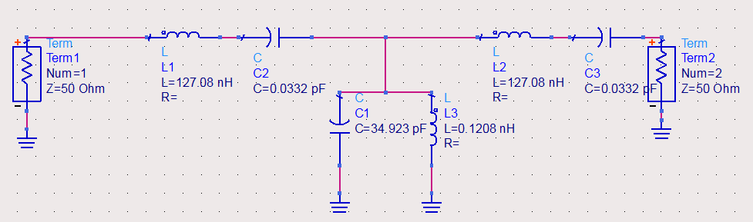
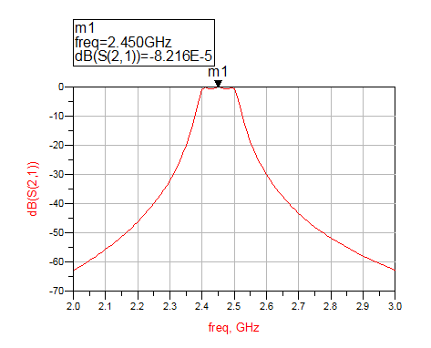
Lumped element low pass filter
Lumped Element Bandpass Filter
Here we cannot advance further by Kuroda Transformation
We use Microstrip couple line method

Slide 4
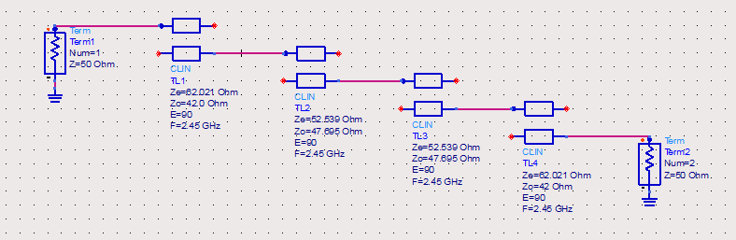
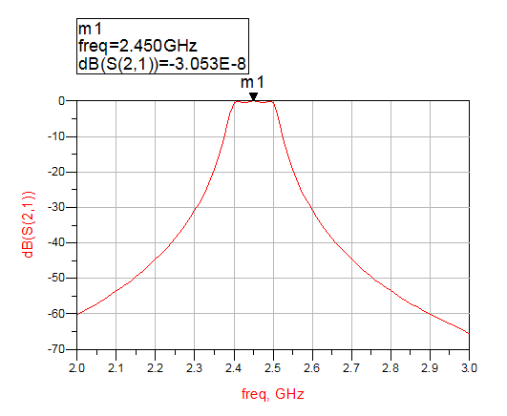
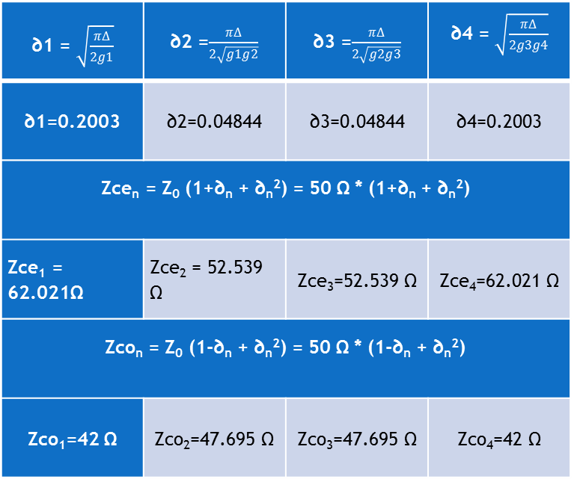
Using the Ideal Couple Line element CLIN in circuit
∂1 = $\sqrt{\frac{πΔ}{2g1}}$ | ∂2 =$\frac{πΔ}{2\sqrt{g1g2}}$ | ∂3 =$\frac{πΔ}{2\sqrt{g2g3}}$ | ∂4 = $\sqrt{\frac{πΔ}{2g3g4}}$
∂1=0.2003 | ∂2=0.04844 | ∂3=0.04844 | ∂4=0.2003
Zce_{n} = Z₀ (1+∂_{n} + ∂_{n}­²) = 50 Ω * (1+∂_{n} + ∂_{n}­²)
Zce₁ = 62.021Ω | Zce₂ = 52.539 Ω | Zce₃=52.539 Ω | Zce₄=62.021 Ω
Zco_{n} = Z₀ (1-∂_{n} + ∂_{n}­²) = 50 Ω * (1-∂_{n} + ∂_{n}­²)
Zco₁=42 Ω | Zco₂=47.695 Ω | Zco₃=47.695 Ω | Zco₄=42 Ω

Slide 5
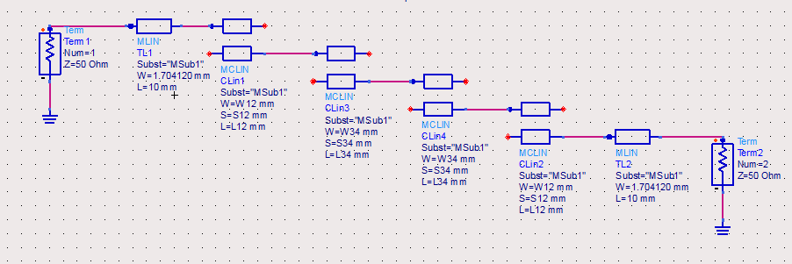
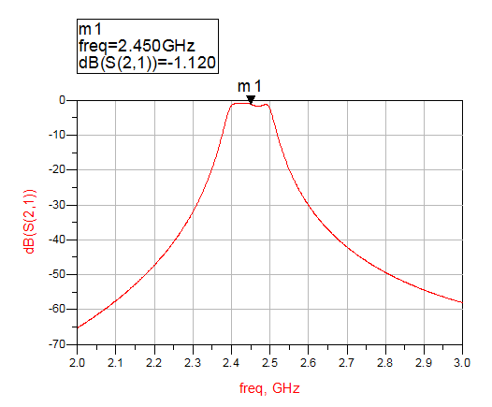
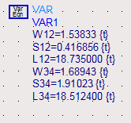
Transforming to Microstrip Couple Line element MCLIN circuit
CLIN is just the ideal electric couple line.
Transforming to microstrip couple line MCLIN.
Using the tool LineCal of ADS, with
Effective Electrical Length E_Eff of coupled section = 90 degree
Center frequency at 2.45 GHz
Add two transmission line MLIN at both terminals. Their widths W(s) are 1.704 mm, it is equivalent to 50 Ohm transmission line.

Slide 6
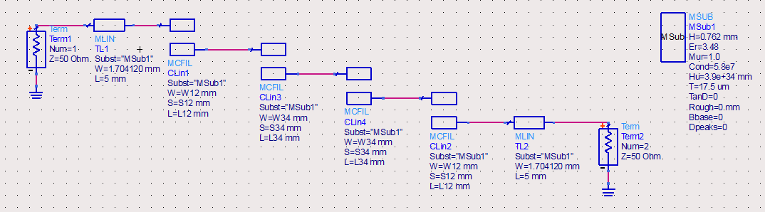
Transforming to Microstrip Couple Line Filter element MCFIL circuit
Using MCFIL let us have a more realistic behavior of our circuit, where the couple line is openly terminated.
Moreover, it also allows ADS count in the case where the Electrical Field create a capacitor run in the air from the couple line, which lead to the fringing effect inside the circuit.
Due to the fringing effect, our center frequency shifted a little bit – around 0.05 GHz to the left.

Slide 7
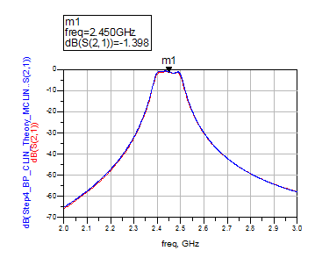
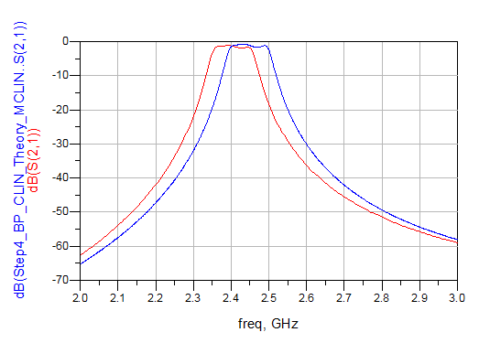
Optimization
Fringing effect only reduce the center frequency without changing the shape of the reflection coefficient behavior
Optimized by increase the initial center frequency by 0.05 GHz and redo the calculation.
In theory, this is the bandpass filter with center frequency at 2.5 GHz.
Create a new circuit with a different center frequency which in reality
behave like the initial filter.

Slide 8
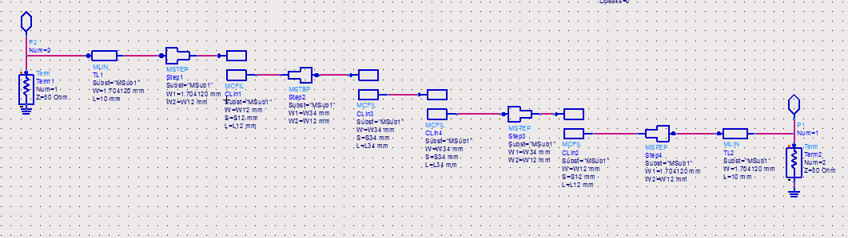
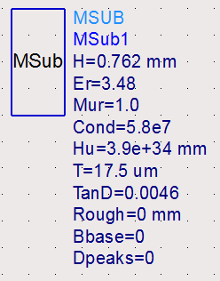
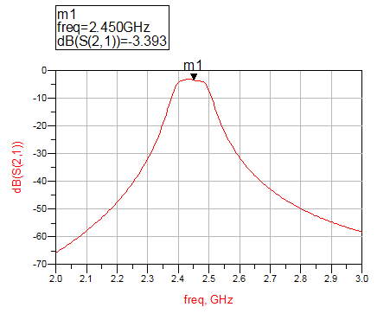
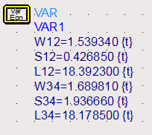
discontinuities
use the MSTEP components to include the differences in width between 2 part of a microstrip line.

Slide 9
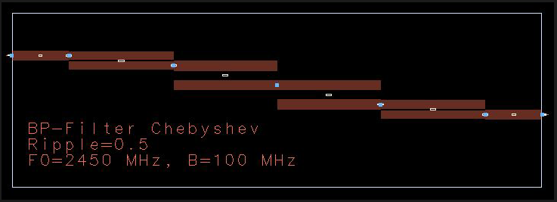
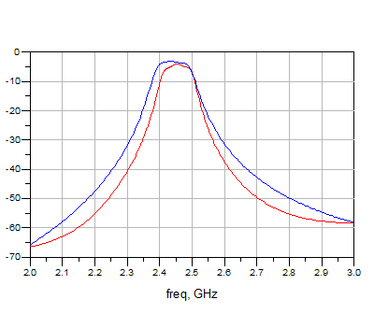
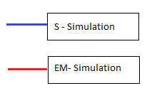
Figure 9: Comparison between momentum and schematic simulation
Circuit layout generated by ADS.
Because of the intervention of the substrate:
Bandwidth decreased, the center frequency shifted, and the power loss increased. Moreover, the ripple also changed.
In other word, the circuit will behave completely different from what we want.

Slide 10
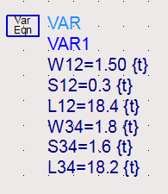
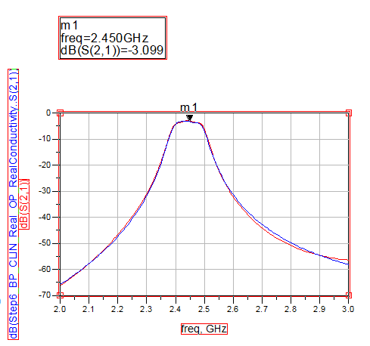
Optimize the circuit to get the best EM simulation result
Completely new filter circuit with different data in theory, but in reality, behave like the initial project bandpass filter: Center frequency 2.45 GHz, bandwidth 100 MHz.

Slide 11
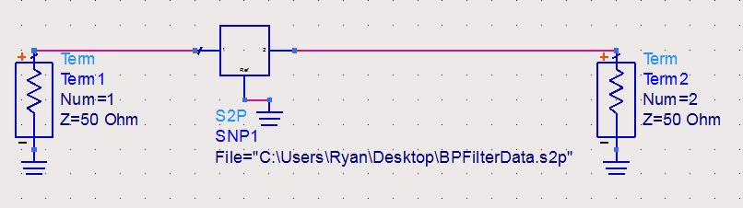
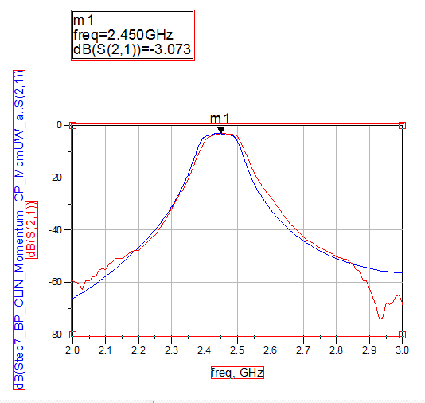
Using Network Analyzer to test the circuit and get the measurement result.
The bandwidth is similar between the real and the simulation
Success in realization.
Error occurred
Center frequency shifted: substrate material, circuit making process.

